Slide 1

Black Box Testing
Testing
Functions
Test Cases
Results
Testing reveled our primary weakness was with the upload/download component of the application. Additionally testing discovered lack of functionality in the statistical module of the program as well.

Slide 2

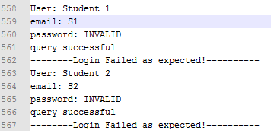
White Box Testing
Example Output
End Results
Findings
White box testing’s failure came from file system checks and maintaining database connectivity. Additionally, it showed a strong backend interface to our database with high reliability for retrieving and linking data. The data was reliably translated into objects, which is the main front end construction of this application.

